Slide 1

Network Virtualization

Slide 2




Changing The Network Architecture
Consolidation
Improved Utilization, Efficiency
Virtualization
Improved Flexibility, Responsiveness
Automation
Policy-based Adaptive Infrastructure
Dynamic Service Automation
Static Provisioning
Semi-Automated Provisioning
Agility
Storage Virtualization
Application Virtualization
Network Virtualization
Server Virtualization
Branch Infrastructure Consolidation
Data Center Consolidation
Storage Consolidation
Server Consolidation
Time
Notes:
2
2
Now, obviously customers are not going to get there in one fell swoop. And we see them moving from -- through a journey. And our job is to help them through that journey. They usually start with consolidation. That's the first aspect they realize in moving forward to do data centers. Whether it be looking out at the branch office environments and using WAAS technology to pull those file systems back, or maybe even rolling out a huge storage network, some component leads them to drive a consolidation perspective.
Once they take that view, they're usually looking one step ahead in how they can virtualize and then optimize those type of services to really drive that TCO argument forward. But the more forward-thinking customers are starting to think about dynamic provisioning. So now how can I enable and scale the dimensions of this problem to be more agile to the business? We believe that this kind of approach and view demands an architectural perspective. If you build a foundation around consolidation and you don't take into account the future, you're never going to get there.
Maibel’s Notes
“state of the network slide”
Technically we have been in the virtualization business sisnce 1994
Virtualization is Changing Network Architectures -it is the only technology that in 15 years has changed the network architecture.
To date Cisco Data Center 3.0 has delivered
Delivered VM Networking
Balanced Virtualization with Scalability, Reliability, and Security
Homogenized the I/O from the server
Enabled Any Workload on Any Server Anywhere
Moved from Hardware Provisioning to Software Provisioning in the Data Center
Purpose-Built Data Center Platforms
Cisco has Built the Unified Fabric for the Data Center

Slide 3
Virtualization—Definition (Well, One of Them)
Virtualization
Is the Pooling and Abstraction of Resources and Services in a Way That Masks the Physical Nature and Boundaries of Those Resources and Services from Their Users
Notes:
Virtualization is a broad and overused term that refers to the abstraction of computer
and network resources. For example, VLAN (Virtual LAN) and VSAN (Virtual
SAN) are forms of network virtualization.
What is becoming increasingly important for data centers is server virtualization,
in particular hardware-assisted server virtualization. Wikipedia® defines it as:
“Hardware-assisted virtualization is a virtualization approach that enables
efficient full virtualization using help from hardware capabilities, primarily
from the host processors.” Full virtualization is used to simulate a complete
hardware environment, or virtual machine, in which an unmodified “guest” operating
system (using the same instruction set as the host machine) executes in
complete isolation. Hardware-assisted virtualization was first implemented on the
IBM® System/370®, and was recently (2007) added to x86 processors (Intel VT®
or AMD-V®).
According to Gartner, “Virtualization is the highest impact trend changing
infrastructure and operations through 2012. It will change how you manage,
how and what you buy, how you deploy, how you plan, and how you charge
[36].” Several studies by the research firm IDC also support this claim. The firm
reports 22 percent of servers today as being virtualized and expects that number
to grow to 45 percent over the next 12 to 18 months [37]. Another IDC study
predicts that the number of logical servers generated on virtualized servers will
surpass the number of non-virtualized physical server units by 2010 [38].
Examples of virtualization solutions in X86-based processor systems include
VMware® vSphere/ESX®, Microsoft Hyper-V®, Linux® KVM®, and Linux® Xen®.
With efficient hardware-assisted virtualization, multiple low-usage servers can be
virtualized (i.e., transformed into a Virtual Machine) and multiple VMs can be
run simultaneously on the same physical server. VMs can also be moved from one
server to another for load balancing or disaster recovery.
Organizations worldwide are already beginning to take advantage of this model.
The 2007 IDC study, for example, showed that 50% of all VMware ESX® users
had adopted VMotion capability [39]. This technology enables live migration—
moving guests from one physical server to another with no impact to end users’
experience. By giving IT managers the ability to move guests on the fly, live migrations
make it easier to balance workloads and manage planned and unplanned
downtimes more efficiently.
UCS, with its large memory footprint and native virtualization support, may help
cut the number of servers by one order of magnitude, thus achieving an even
larger power saving.

Slide 4
Objective
Identify the roles of Network Virtualization
State the benefits of VDC and VRF
Describe the steps to configure VRF
Describe the similarities and differences between VSS and vPC
Describe the terminologies, forwarding behaviour and failure scenarios of a vPC system

Slide 5
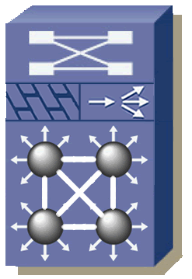





Role of Network Virtualization
Address the use of network functionality in support of virtualized compute environments
Virtualization of network elements
Front-End Virtualization
VLAN
VRF
VDC
VSS
VPNs
Front-End
Virtual Network Services
Virtual Firewall Context
1
Virtual
SSL Context
3
Virtual Firewall Context
1
Virtual Firewall Context
1
Virtual
SLB Context
29
Virtual
SSL Context
3
Virtual
SSL Context
175
Virtual Machines
Virtual SANs/Unified IO
Back-End
VSANs
vHBA
CNA
FCoE
Virtual Storage
Notes:
Network Virtualization
The role of the network in the virtualization space should address two complementary
aspects: first, the use of network functionality in support of virtualized
compute environments, and second the virtualization of the network elements.
When planning for disaster recovery or managing workloads across multiple data
center facilities, larger and pervasive Layer 2 networks provide a multitude of
operational advantages.
Larger and multi-site layer 2 networks should not create an unnecessary operational
burden and should maintain the scalability and stability provided today by
IP networks.
A promising solution is the evolution of technologies based upon the concept of
“MAC routing”, which enables VPN solutions in which Layer 2 connectivity can
be provided between separate Layer 2 domains, while preserving all the benefits
of an IP-based interconnection. This is a significant step forward in data center
interconnection solutions.
In MAC routing, Layer 2 reachability information is distributed in a control
protocol much like that used in a Layer 3 network. This protocol learning is the
cornerstone to maintaining the failure containment and loop-free path diversity
characteristics of an IP network while still providing Layer 2 connectivity. There
are techniques in MAC routing to ensure that reconvergence events, broadcasts
and unknown unicast flooding can be localized and kept from propagating to
multiple data centers.
In the MAC routing model, traffic forwarding is done natively in IP, which makes
the solution transport agnostic. The network architect now has the freedom of
leveraging any Layer 1, Layer 2, or Layer 3 service between their data centers.
The key here is that the operational model does not change from one transport to
another. Thus, there are not any complex interactions between the transport core
and the overlaid Layer 2 extensions. This is a big departure from the transport
restrictions imposed by current label-switched VPN technologies. In short, MAC
routing is totally transparent to the core and therefore minimizes the impact on
design and operations that the extension of Layer 2 may impose on the network.
The Nexus 7000 is the first Cisco platform that provides MAC routing functionality
at the L2/L3 boundary, maintaining the benefits of L3 routing between Layer
2 domains that may require Layer 2 connectivity. The Layer 3 intelligence may be
realized in the underlying IP core or on the overlay control plane itself, allowing
inter-domain Layer 2 traffic to inherit the wide variety of enhancements traditionally
seen in a Layer 3 network. Some examples include: loop-free multipathing
that enables load distribution for high-bandwidth interconnect, optimal Multicast
replication, single control plane for multicast and unicast, Fast Re-route with
Equal Cost Multi-Path routing.
MAC routing enables Layer 2 VPN solutions, which by extension enable Layer 3
VPN solutions. These are used more and more in order to virtualize the network
itself and realize the consolidation benefits of a virtual network environment.

Slide 6
Network Virtualization – One to Many
One network supports many virtual networks
Outsourced
IT Department
Merged New Company
Segregated Department (Regulatory Compliance)
Virtual
Virtual
Virtual
Data Center Front-End Network/LAN

Slide 7
Network Virtualization – Many to One
One network consolidates many physical networks
Security Network
Guest/Partner Network
Backup Network
Out-of-Band Management Network
Data Center Network

Slide 8
Virtual Device Contexts (VDC)
VDC provides virtualization at the device level allowing multiple instances of the device to operate on the same physical switch at the same time
L2 Protocols
L3 Protocols
L2 Protocols
L3 Protocols
VLAN Mgr
UDLD
OSPF
GLBP
VLAN Mgr
UDLD
OSPF
GLBP
VLAN Mgr
UDLD
BGP
HSRP
VLAN Mgr
UDLD
BGP
HSRP
LACP
CTS
EIGRP
VRRP
…
LACP
CTS
EIGRP
VRRP
IGMP
802.1x
PIM
SNMP
IGMP
802.1x
PIM
SNMP
RIB
RIB
RIB
RIB
Protocol Stack (IPv4/IPv6/L2)
Protocol Stack (IPv4/IPv6/L2)
VDC1
VDCn
Infrastructure
Kernel
Nexus 7000 Physical Switch

Slide 9
Understanding Virtual Device Context VDC C
https://www.youtube.com/watch?v=x41zkbdh_q4

Slide 10
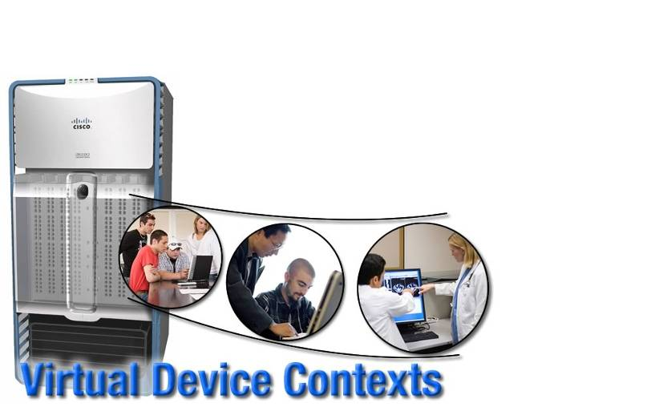
Properties of the VDC
The hardware is shared across the VDCs but from the user, configuration and management perspective, the VDC should appear as a standalone device
Each VDC treated as standalone device with limited resources
Each VDC uniquely identified by ID or name
Each VDC has unique MAC address assigned to identify VDC
Shared processor, shared linecards, and dedicated interfaces
Per VDC role-based management allows per VDC admin configuration and management
Software fault isolation for protocol processes within the VDC
Notes:
The Nexus 7000 NX-OS software supports Virtual Device Contexts (VDCs), VDC(s)
allow the partitioning of a single physical Nexus 7000 device into multiple logical
devices. This logical separation provides the following benefits:
■ Administrative and management separation
■ Change and failure domain isolation from other VDCs
■ Address, VLAN, VRF, and vPC isolation
Each VDC appears as a unique device and allows for separate Roles-Based Access
Control Management (RBAC) per VDC. This enables VDCs to be administered by different
administrators while still maintaining a rich, granular RBAC capability. With this functionalit,
each administrator can define virtual routing and forwarding instance (VRF)
names and VLAN IDs independent of those used in other VDCs safely with the knowledge
that VDCs maintain their own unique software processes, configuration, and dataplane
forwarding tables.
Each VDC also maintains an individual high-availability (HA) policy that defines the
action that the system will take when a failure occurs within a VDC. Depending on the
hardware configuration of the system, there are various actions that can be performed. In
a single supervisor system, the VDC can be shut down, restarted, or the supervisor can
be reloaded. In a redundant supervisor configuration, the VDC can be shut down,
restarted, or a supervisor switchover can be initiated.

Slide 11

VDC Fault Domain
A VDC builds a fault domain around all running processes within that VDC—should a fault occur in a running process, It is truly isolated from other running processes and they will not be impacted
VDC A
VDC B
Fault Domain
Process “DEF” in VDC B Crashes
Process DEF in VDC A Is Not Affected and Will Continue to Run Unimpeded
Process ABC
…
…
Process DEF
Process XYZ
Process ABC
Process DEF
Process XYZ
Protocol Stack
Protocol Stack
VDCA
VDCB
Infrastructure
Kernel
Physical Switch

Slide 12

VDC Resource Utilization (Layer 2)
Layer 2 Learning with Multiple Active VDCs Also Has an Impact on Resource Utilization—MAC Addresses Learnt in a VDC Are Only Propagated to Other Linecards When That Linecard Has a Port in That VDC
Switch Fabric
X
Linecard 1
Linecard 2
Linecard 3
MAC Table
MAC Table
MAC Table
MAC “A”
MAC “A”
1/1
1/2
1/3
1/4
2/1
2/2
2/3
2/4
3/1
3/2
3/3
3/4
VDC 10
VDC 20
VDC 20
VDC 10
VDC 30
VDC 20
VDC 30
MAC Address A
MAC “A” Is Propagated to Linecard 2 and 3 but Only Linecard 2 Installs MAC Due to Local Port Being In VDC 10

Slide 13
VDC Resource Utilization (Layer 3)
When Only the Default VDC Is Active, the FIB and ACL TCAM on Each Linecard Is Primed with Forwarding Prefixes and Policies Associated with That Default VDC as Shown Below
Linecard 1
Linecard 2
Linecard 3
Linecard 4
Linecard 5
Linecard 6
Linecard 7
Linecard 8
FIB TCAM
FIB TCAM
FIB TCAM
FIB TCAM
FIB TCAM
FIB TCAM
FIB TCAM
FIB TCAM
128K
128K
128K
128K
128K
128K
128K
128K
ACL TCAM
ACL TCAM
ACL TCAM
ACL TCAM
ACL TCAM
ACL TCAM
ACL TCAM
ACL TCAM
64K
64K
64K
64K
64K
64K
64K
64K

Slide 14
VDC Resource Utilization (Layer 3)
FIB and ACL TCAM Resources Are More Effectively Utilized
VDC 10
VDC 20
VDC 30
Linecard 1
Linecard 2
Linecard 3
Linecard 4
Linecard 5
Linecard 6
Linecard 7
Linecard 8
FIB TCAM
FIB TCAM
FIB TCAM
FIB TCAM
FIB TCAM
FIB TCAM
FIB TCAM
FIB TCAM
128K
128K
128K
128K
128K
128K
128K
128K
ACL TCAM
ACL TCAM
ACL TCAM
ACL TCAM
ACL TCAM
ACL TCAM
ACL TCAM
ACL TCAM
64K
64K
64K
64K
64K
64K
64K
64K

Slide 15
VRF Overview What Is a VRF (Virtual Routing and Forwarding)?
Typically all route processes and static routes are populating one routing table
All interfaces are part of the global routing table
Global Routing Table
router eigrp 1
network 10.1.1.0 0.0.0.255
!
router ospf 1
network 10.2.1.0 0.0.0.255 area 0
!
router bgp 65000
neighbor 192.168.1.1 remote-as 65000
!
ip route 0.0.0.0 0.0.0.0 140.75.138.114

Slide 16
VRF Overview What Is a VRF (Virtual Routing and Forwarding)?
VRFs allow dividing up your routing table into multiple virtual tables
Routing protocol extensions allow binding a process/address family to a VRF
Interfaces are bound to a VRF using ip vrf forwarding <vrf-name>
Global Routing Table
router eigrp 1
network 10.1.1.0 0.0.0.255
!
router ospf 1 vrf orange
network 10.2.1.0 0.0.0.255 area 0
!
router bgp 65000
address-family ipv4 vrf blue
…
!
ip route vrf green 0.0.0.0 0.0.0.0 …

Slide 17
Common Data Center Challenges
Traditional Data Center Designs Are Requiring Ever Increasing Layer 2 Adjacencies Between Server Nodes Due to Prevalence of Virtualization Technology. However, They Are Pushing the Limits of Layer 2 Networks, Placing More Burden on Loop-Detection Protocols Such as Spanning Tree…
FHRP, HSRP, VRRP
Spanning Tree
Policy Management
L2/L3 Core
Single Active Uplink per VLAN (PVST), L2 Reconvergence, Excessive BPDUs
L2
Distribution
Dual-Homed Servers to Single Switch, Single Active Uplink per VLAN (PVST), L2 Reconvergence
L2 Access

Slide 18
EtherChannel
EtherChannel is a port aggregation technology to aggregate several physical Ethernet links to create one logical Ethernet link with a bandwidth equal to the sum of the bandwidths of the aggregated links.
EtherChannel can aggregate from 2 to 16 links and all higher-level protocols see these multiple links as a single connection.
EtherChannel provides fault-tolerance and high-speed links between switches, without blocking any port and therefore using all the links.
A limitation of EtherChannel is that all the physical ports in the aggregation group must be between two switches.
Notes:
EtherChannel
The first possibility is to connect FI1 to a single switch (e.g., SW1), thus avoiding
any loop. The connection itself can be made highly available using multiple links
in parallel with EtherChannel.
EtherChannel is a port aggregation technology primarily introduced by Cisco® in
1994 and standardized by IEEE in 2000 in the project IEEE 802.3ad. EtherChannel
allows aggregating several physical Ethernet links to create one logical Ethernet
link with a bandwidth equal to the sum of the bandwidths of the aggregated
links. EtherChannel can aggregate from 2 to 16 links and all higher-level protocols
see these multiple links as a single connection. This is beneficial for providing
fault-tolerance and high-speed links between Fabric Interconnects and the LAN
backbone, without blocking any port and therefore using all the links. A limitation
of EtherChannel is that all the physical ports in the aggregation group must
be between one Fabric Interconnect and one LAN switch. For this reason, the
next solutions—VSS, vPC, L2MP, and Ethernet Host Virtualizer—were developed.

Slide 19
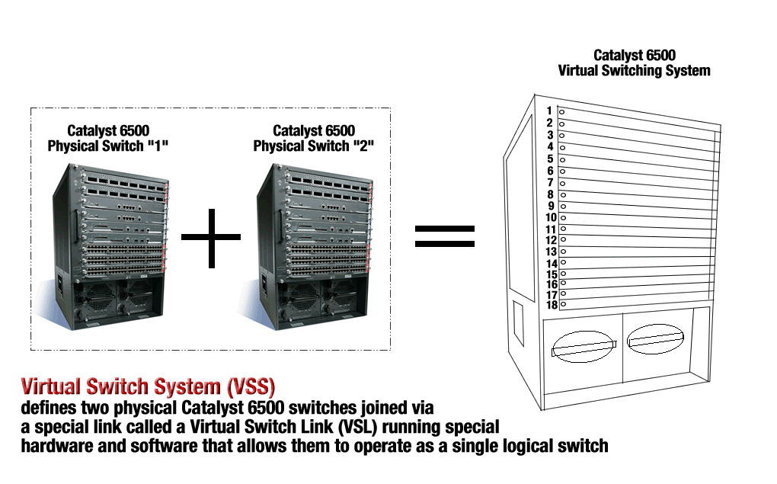
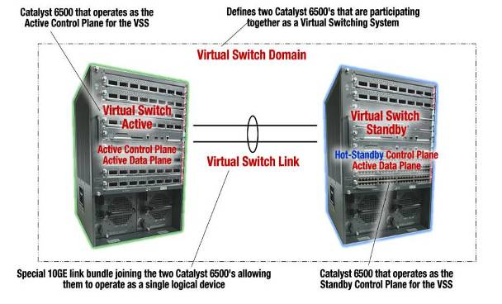
Virtual Switch System
Virtual Switch System Is a New Technology Break Through for the Cisco Catalyst 6500 Family
Notes:
VSS
VSS (Virtual Switching System) is the first of two Cisco® technologies that allows
using EtherChannel from a Fabric Interconnect to two LAN switches avoiding
any blocked port. VSS accomplishes this by clustering the two LAN switches
SW1 and SW2 into a single, managed, and logical entity. The individual chassis
become indistinguishable and therefore each Fabric Interconnect believes the
upstream LAN switches to be a single STP (Spanning Tree Protocol) bridge, and
EtherChannel can be deployed unmodified on the Fabric Interconnect. VSS has
also other advantages; since it improves high availability, scalability, management,
and maintenance, see [17] for more details. Today VSS is deployed on the Catalyst
6500 switches.

Slide 20
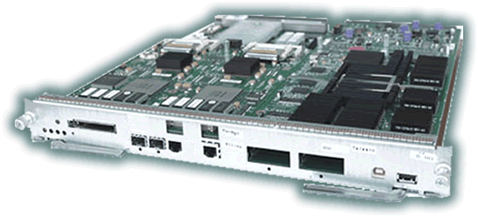
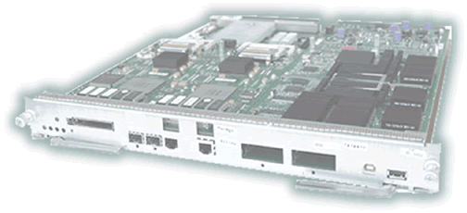
Virtual Switch Architecture Forwarding Operation
In Virtual Switch Mode, While Only One Control Plane Is Active, Both Data Planes (Switch Fabrics) Are Active, and as Such, Each Can Actively Participate in the Forwarding of Data
Switch 1—Control Plane Active
Switch 2—Control Plane Hot Standby
Virtual Switch Domain
Switch 1—Data Plane Active
Switch 2—Data Plane Active
Virtual Switch Domain

Slide 21
Summary
Roles of Network Virtualization
Benefits of VDC
Benefits and configuration of VRF

